Slide 1
IDENTIFIERS (KEYS)
Identifier (Key)–an attribute (or combination of attributes) that uniquely identifies individual instances of an entity type
Simple versus Composite Identifier
Candidate Identifier–an attribute that could be a key…satisfies the requirements for being an identifier
Notes:
6

Slide 2
CRITERIA FOR IDENTIFIERS
Choose Identifiers that
  Will not change in value
  Will not be null
Avoid intelligent identifiers (e.g., containing locations or people that might change)
Substitute new, simple keys for long, composite keys
Notes:
7

Slide 3
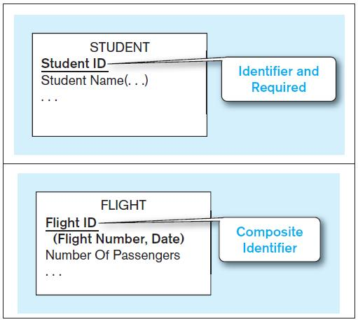


Figure 2-9 Simple and composite identifier attributes
The identifier is boldfaced and underlined
Chapter 2
© 2013 Pearson Education, Inc. Publishing as Prentice Hall
Notes:
14

Slide 4
MODELING RELATIONSHIPS
Relationship Types vs. Relationship Instances
  The relationship type is modeled as lines between entity types…the instance is between specific entity instances
Relationships can have attributes
  These describe features pertaining to the association between the entities in the relationship
Two entities can have more than one type of relationship between them (multiple relationships)
Associative Entity–combination of relationship and entity

Slide 5
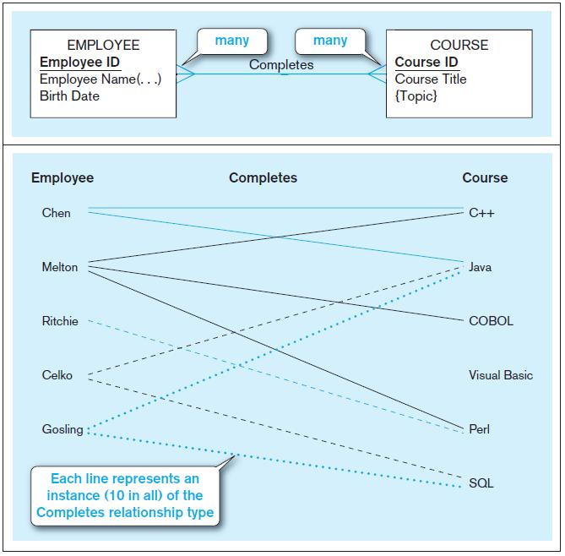
Figure 2-10 Relationship types and instances
a) Relationship type (Completes)
b) Relationship instances
Chapter 2
© 2013 Pearson Education, Inc. Publishing as Prentice Hall
Notes:
17

Slide 6
DEGREE OF RELATIONSHIPS
Degree of a relationship is the number of entity types that participate in it
  Unary Relationship
  Binary Relationship
  Ternary Relationship
Notes:
16

Slide 7
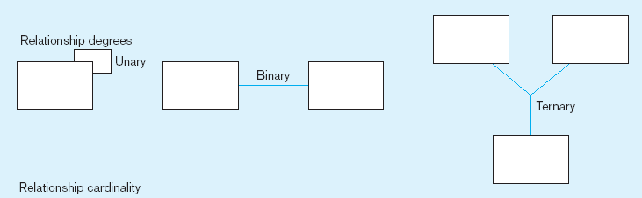
Degree of relationships – from Figure 2-2
Entities of two different types related to each other
One entity related to another of the same entity type
Entities of three different types related to each other
© 2013 Pearson Education, Inc. Publishing as Prentice Hall
Notes:
8

Slide 8
CARDINALITY OF RELATIONSHIPS
One-to-One
  Each entity in the relationship will have exactly one related entity
One-to-Many
  An entity on one side of the relationship can have many related entities, but an entity on the other side will have a maximum of one related entity
Many-to-Many
  Entities on both sides of the relationship can have many related entities on the other side

Slide 9
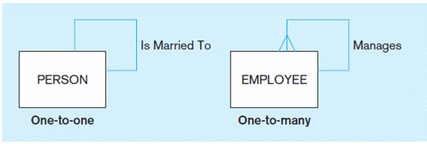
Figure 2-12 Examples of relationships of different degrees
a) Unary relationships
© 2013 Pearson Education, Inc. Publishing as Prentice Hall
Notes:
22

Slide 10
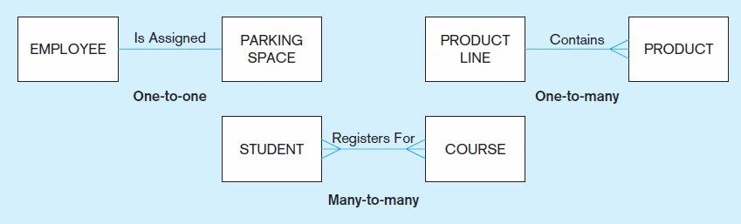
Figure 2-12 Examples of relationships of different degrees (cont.)
b) Binary relationships
Chapter 2
© 2013 Pearson Education, Inc. Publishing as Prentice Hall
Notes:
22

Slide 11
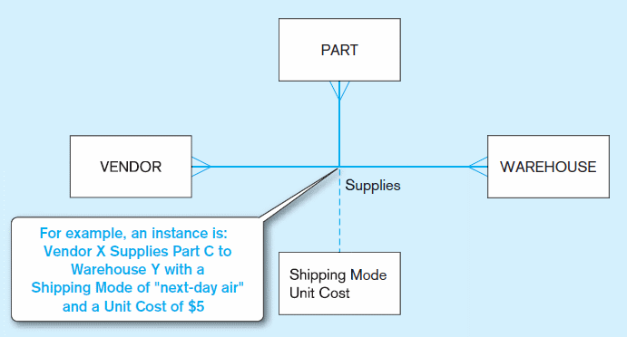
Figure 2-12 Examples of relationships of different degrees (cont.)
c) Ternary relationship
Note: a relationship can have attributes of its own
Chapter 2
© 2013 Pearson Education, Inc. Publishing as Prentice Hall
Notes:
22

Slide 12
CARDINALITY CONSTRAINTS
Cardinality Constraints—the number of instances of one entity that can or must be associated with each instance of another entity
Minimum Cardinality
  If zero, then optional
  If one or more, then mandatory
Maximum Cardinality
  The maximum number
Notes:
29

Slide 13
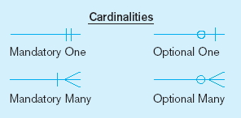
Figure 2-17 Examples of cardinality constraints
a) Mandatory cardinalities
A patient must have recorded at least one history, and can have many
A patient history is recorded for one and only one patient
Chapter 2
© 2013 Pearson Education, Inc. Publishing as Prentice Hall
Notes:
1

Slide 14
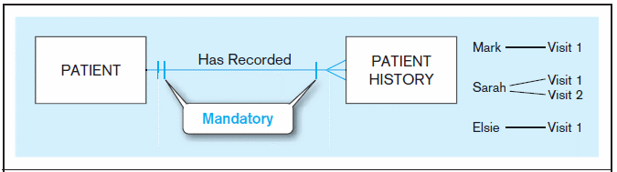
Figure 2-17 Examples of cardinality constraints
a) Mandatory cardinalities
A patient history is recorded for one and only one patient
A patient must have recorded at least one history, and can have many
Chapter 2
© 2013 Pearson Education, Inc. Publishing as Prentice Hall
Notes:
1

Slide 15
Figure 2-17 Examples of cardinality constraints (cont.)
b) One optional, one mandatory
An employee can be assigned to any number of projects, or may not be assigned to any at all
A project must be assigned to at least one employee, and may be assigned to many
Chapter 2
© 2013 Pearson Education, Inc. Publishing as Prentice Hall
Notes:
1

Slide 16
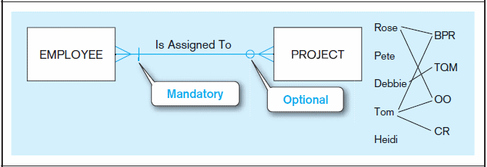
Figure 2-17 Examples of cardinality constraints (cont.)
b) One optional, one mandatory
A project must be assigned to at least one employee, and may be assigned to many
An employee can be assigned to any number of projects, or may not be assigned to any at all
Chapter 2
© 2013 Pearson Education, Inc. Publishing as Prentice Hall
Notes:
1

Slide 17
Figure 2-17 Examples of cardinality constraints (cont.)
c) Optional cardinalities
A person is married to at most one other person, or may not be married at all
Chapter 2
© 2013 Pearson Education, Inc. Publishing as Prentice Hall
Notes:
1

Slide 18
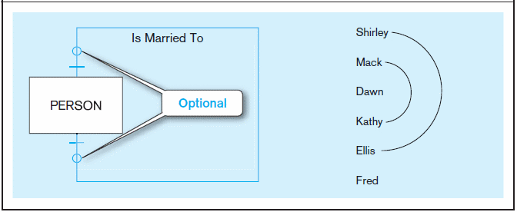
Figure 2-17 Examples of cardinality constraints (cont.)
c) Optional cardinalities
A person is married to at most one other person, or may not be married at all
Chapter 2
© 2013 Pearson Education, Inc. Publishing as Prentice Hall
Notes:
1

Slide 19
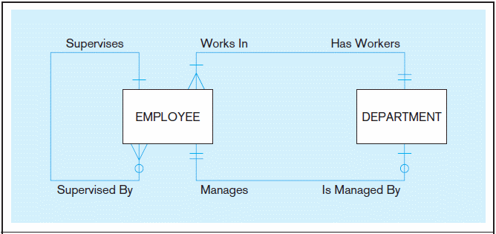
Figure 2-21 Examples of multiple relationships
a) Employees and departments
Entities can be related to one another in more than one way
Chapter 2
© 2013 Pearson Education, Inc. Publishing as Prentice Hall
Notes:
40

Slide 20
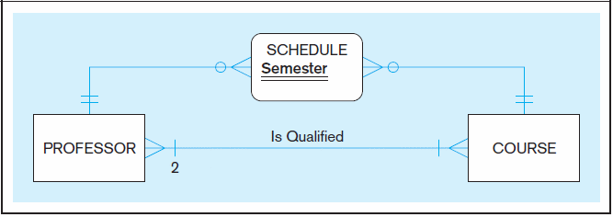
Figure 2-21 Examples of multiple relationships (cont.)
b) Professors and courses (fixed lower limit constraint)
Here, min cardinality constraint is 2 A given course must have at a minimum two qualified instructors. Conversely, each instructor must be qualified to teach at least one course.
i.e. At least two professors must be qualified to teach each course. Each professor must be qualified to teach at least one course.
Chapter 2
© 2013 Pearson Education, Inc. Publishing as Prentice Hall
Notes:
40

Slide 21
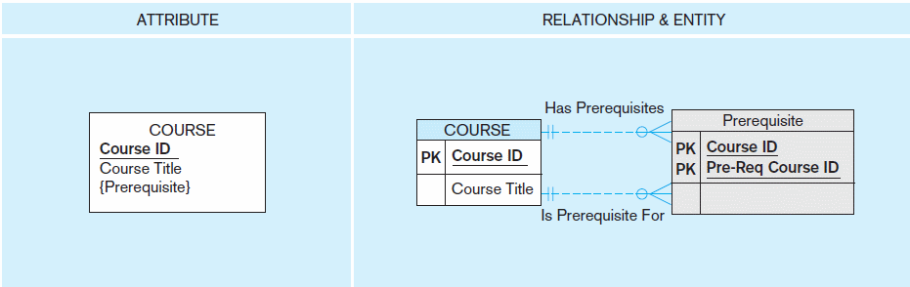
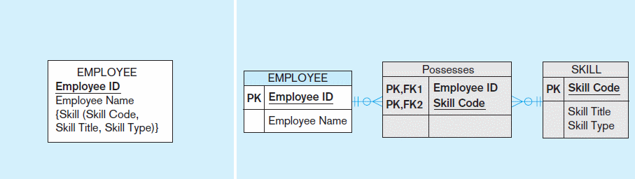
Figure 2-15a and 2-15b Multivalued attributes can be represented as relationships
simple
composite
Chapter 2
© 2013 Pearson Education, Inc. Publishing as Prentice Hall

Slide 22
ASSOCIATIVE ENTITIES
An entity–has attributes
A relationship–links entities together
When should a relationship with attributes instead be an associative entity?
  All relationships for the associative entity should be many
  The associative entity could have meaning independent of the other entities
  The associative entity preferably has a unique identifier, and should also have other attributes
  The associative entity may participate in other relationships other than the entities of the associated relationship
  Ternary relationships should be converted to associative entities

Slide 23
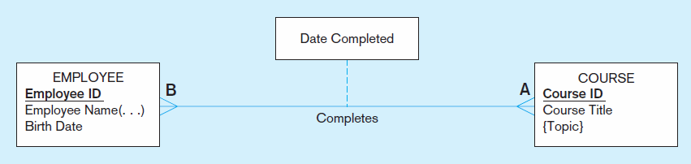
Figure 2-11a A binary relationship with an attribute
Here, the date completed attribute pertains specifically to the employee’s completion of a course…it is an attribute of the relationship.
Chapter 2
© 2013 Pearson Education, Inc. Publishing as Prentice Hall
Notes:
20

Slide 24
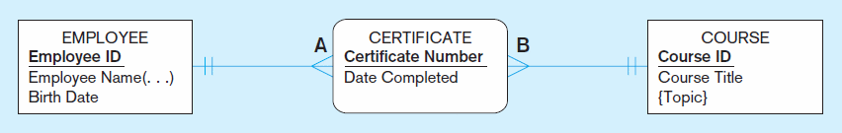
Figure 2-11b An associative entity (CERTIFICATE)
Associative entity is like a relationship with an attribute, but it is also considered to be an entity in its own right.
Note that the many-to-many cardinality between entities in Figure 2-11a has been replaced by two one-to-many relationships with the associative entity.
Chapter 2
© 2013 Pearson Education, Inc. Publishing as Prentice Hall
Notes:
21

Slide 25
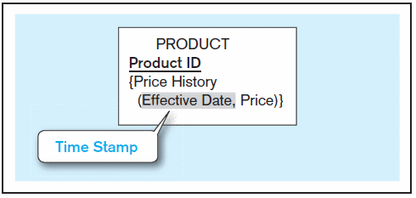
Figure 2-19 Simple example of time-stamping
The Price History attribute is both multivalued and composite.
Time stamp – a time value that is associated with a data value, often indicating when some event occurred that affected the data value
Chapter 2
© 2013 Pearson Education, Inc. Publishing as Prentice Hall
Notes:
37

Slide 26
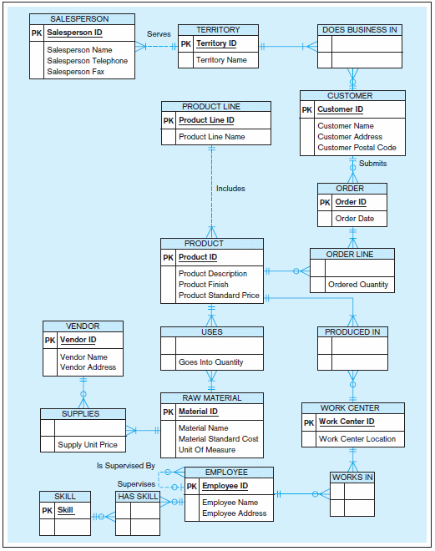
Figure 2-22
Data model for Pine Valley Furniture Company in Microsoft Visio notation
Different modeling software tools may have different notation for the same constructs.
Chapter 2
© 2013 Pearson Education, Inc. Publishing as Prentice Hall

